Slide 1
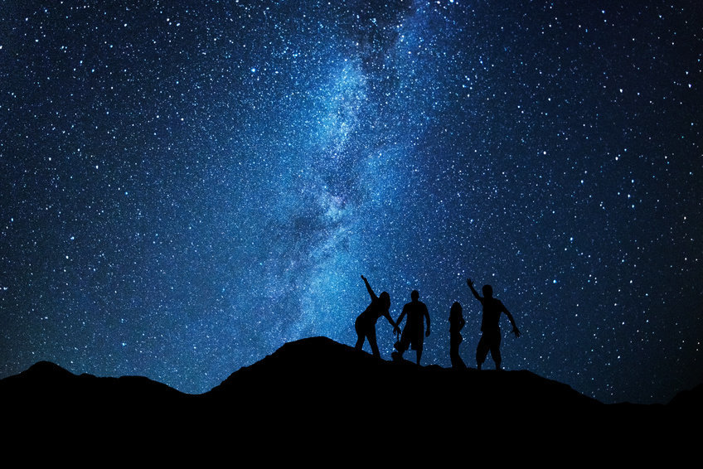
Strong lensing constraints on modified gravity models
De-Chang Dai
Yangzhou University
5th International Workshop on
Dark Matter, Dark Energy and Matter-Antimatter Asymmetry
暗物質、暗能量及物質-反物質不對稱

Slide 2
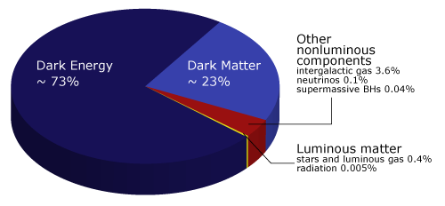
Modified gravity models
Replace dark matter
Replace dark energy
Change geometry
Change Einstein tensor
………..

Slide 3
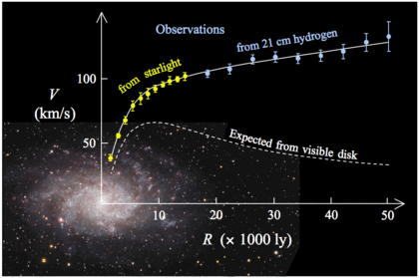
Galaxy rotation curve
Imply
Dark matter
In a talk given in 1884, Lord Kelvin thus concluded that “many of our stars, perhaps a great majority of them, may be dark bodies.”

Slide 4
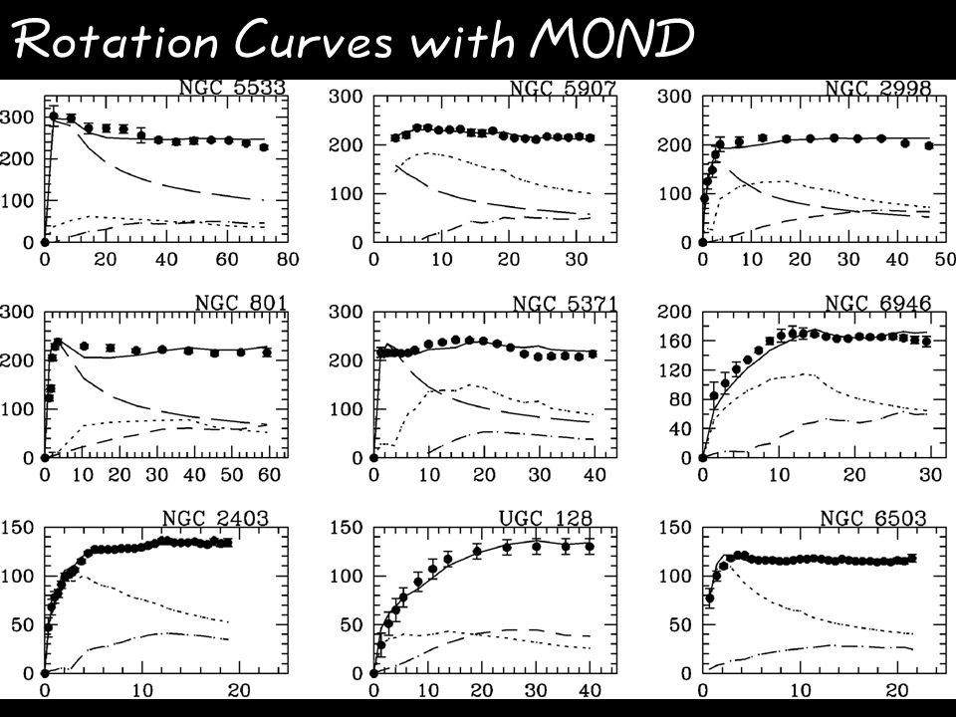
1983 by
Mordehai Milgrom

Slide 5

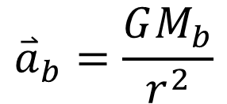
Modified Newtonian Dynamics (MOND)
$${\overset{⃑}{a}}_{b}=\frac{GM_{b}}{r^{2}}$$

Slide 6
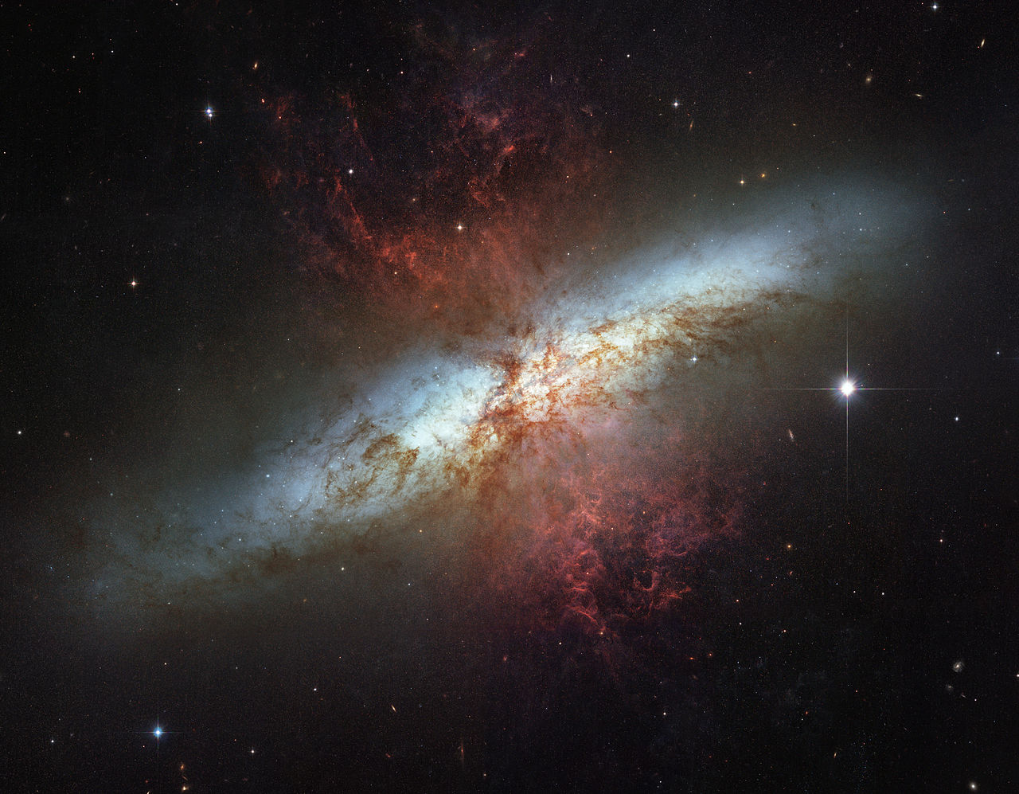

Extra assumption:
Luminosity
Mass

Slide 7
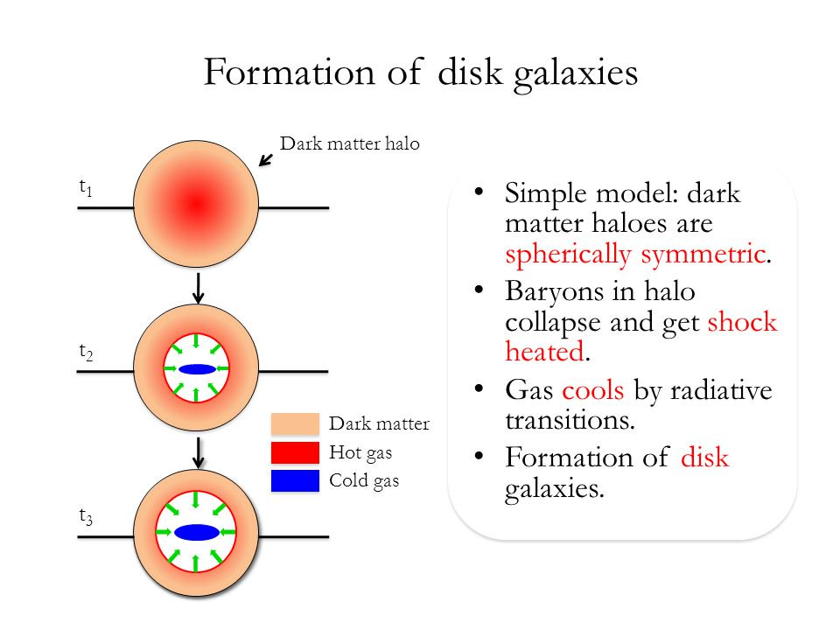

Slide 8
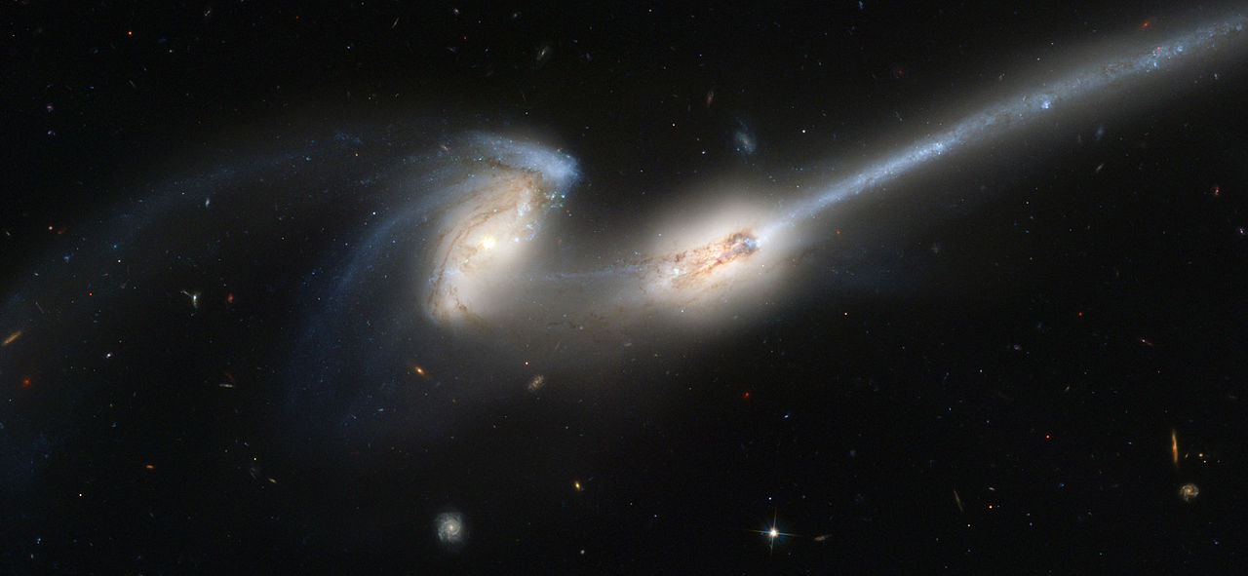
Galaxy merger

Slide 9
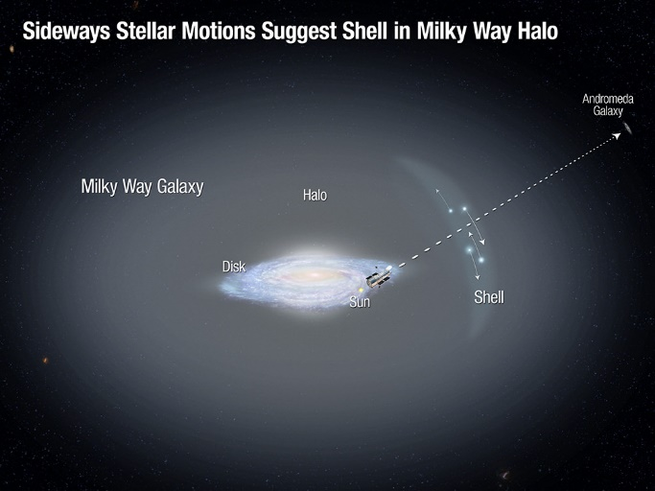
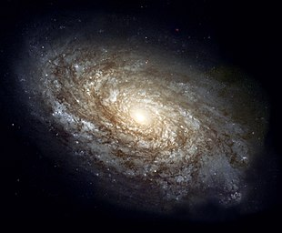


Dark matter shell or modified gravity?

Slide 10
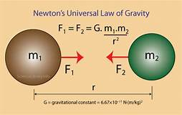
Problem
Momentum does not conserve.
No Lagrangian
Empirical function

Slide 11
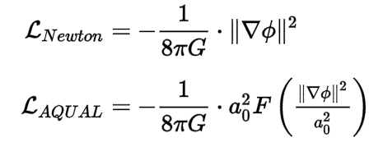
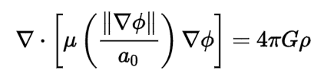
Complete MOND theories
Equation of motion

Slide 12

MOND behavior is the first thing to check
in a modified gravity model which is proposed to
Solve dark matter problem..

Slide 13
Theories replace Dark matter
TeVes
Verlinde’s emergent gravity
Superfluid dark matter model

Slide 14




Superfluid models

Slide 15
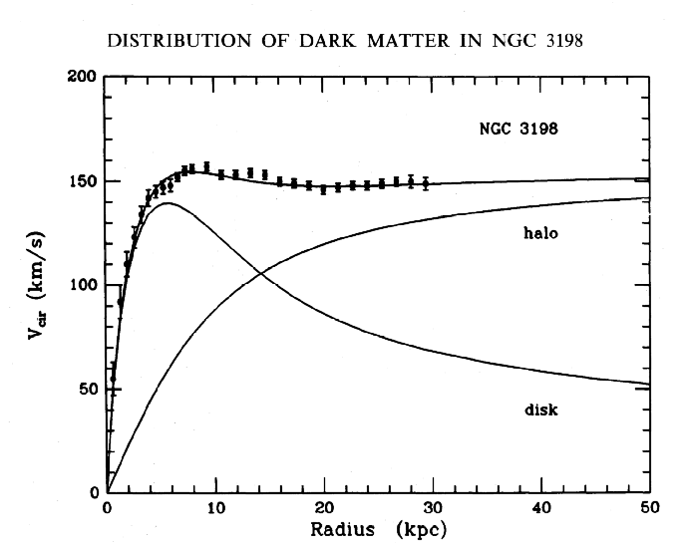
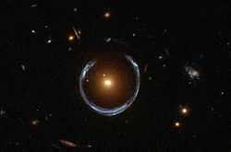
There are two types of data.
Galactic Rotation curve
Galactic strong lensing

Slide 16
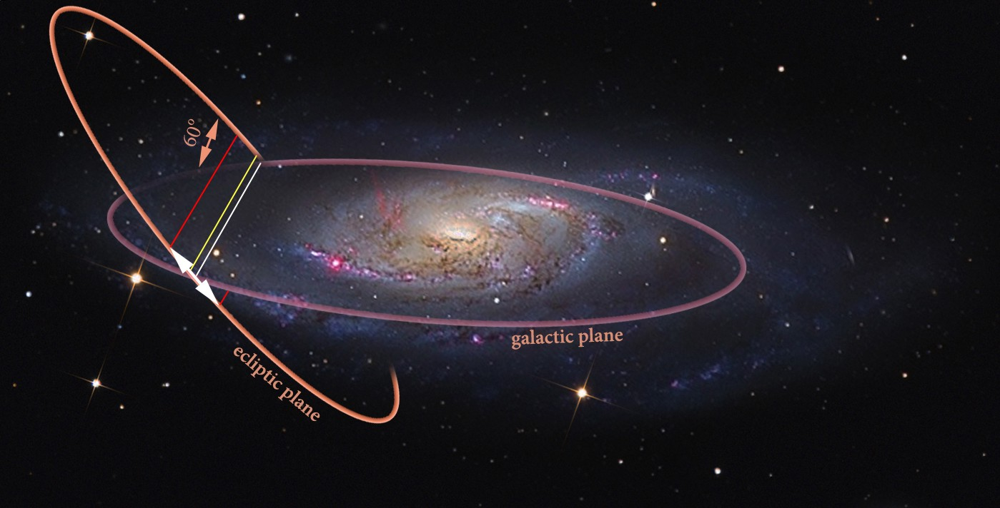
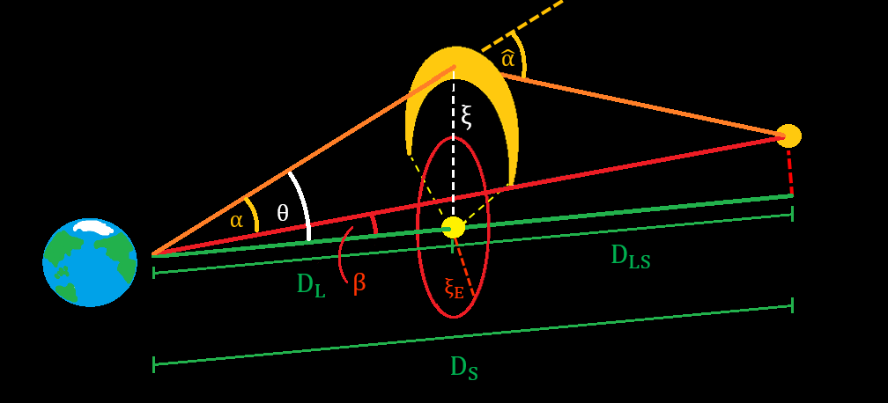
Problem: Where is the photon coupling term?

Slide 17


Previous work on Strong lensing constrains on modified gravity
arXiv:1809.00840

Slide 18



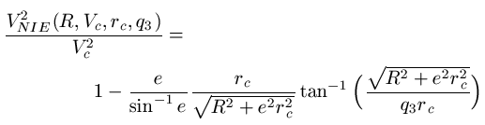

Slide 19
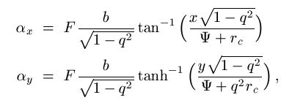
Lensing deflection angle
F=1+Γ

Slide 20
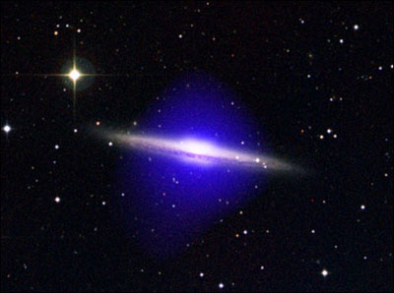
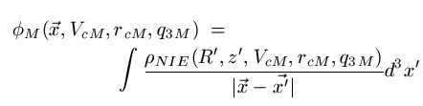

Extra field
Bulge and disk

Slide 21
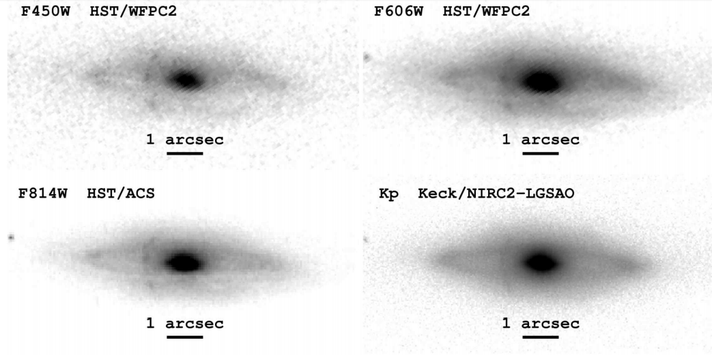

Slide 22
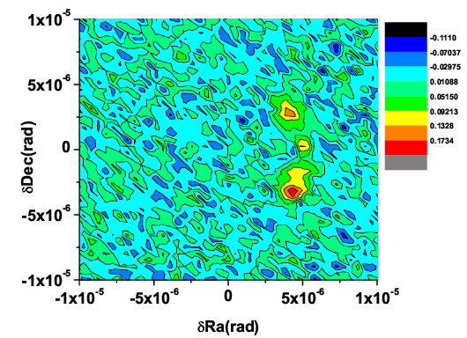
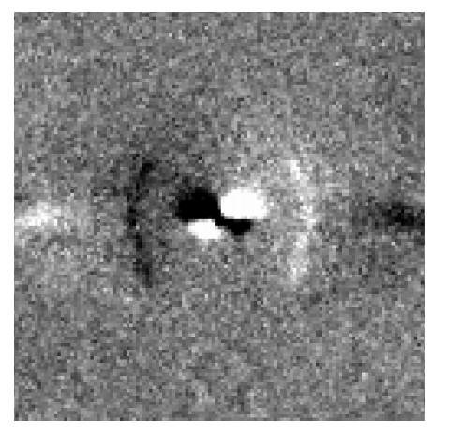
After removing the lensing galaxy

Slide 23
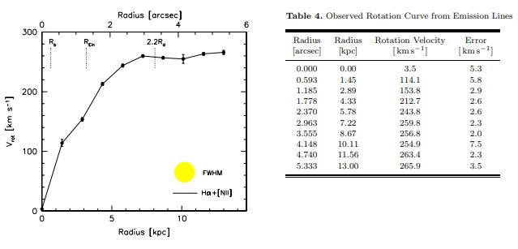
Rotation curve
arXiv:1101.1622

Slide 24
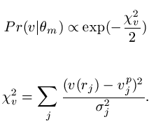
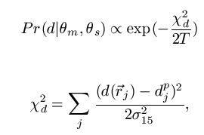
Dynamics
Strong lensing

Slide 25
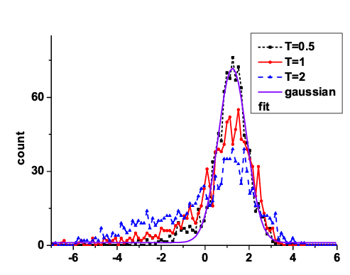
Result

Slide 26
Conclusion:
Some of the Modified gravity models are not complete.
Constraint on modified gravity models:

